Slide 1
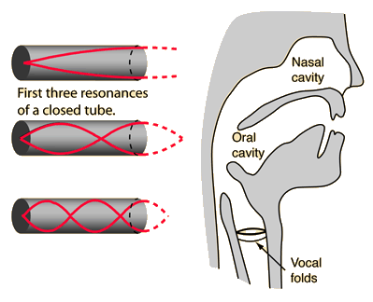
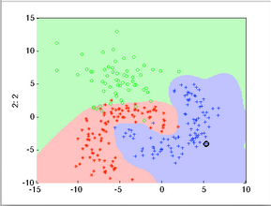
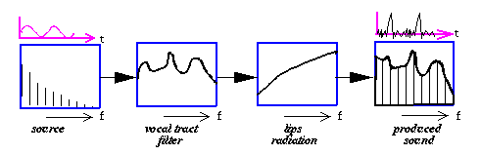
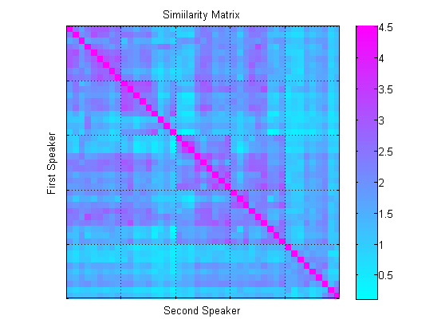
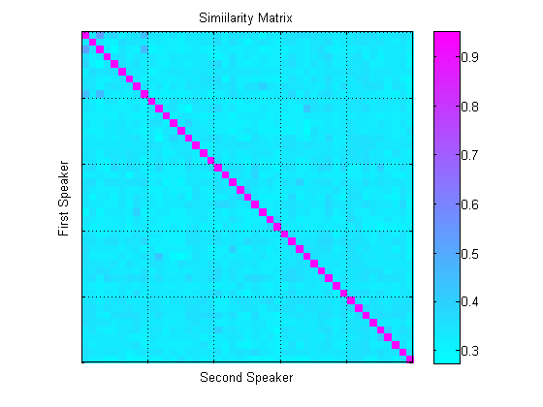
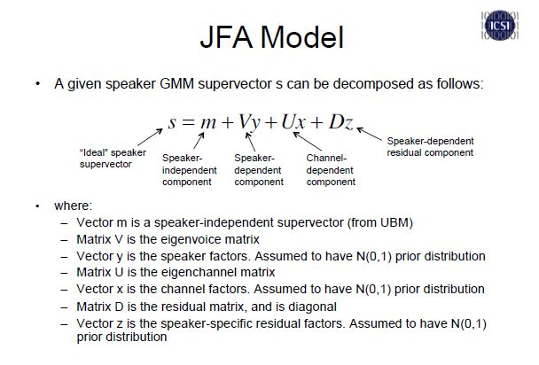
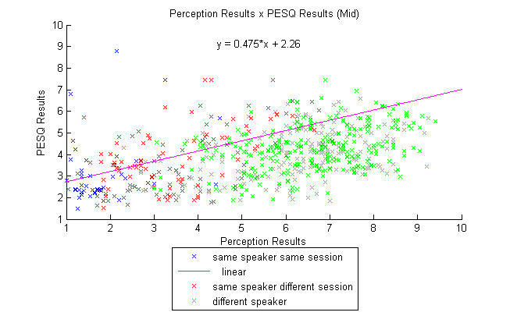
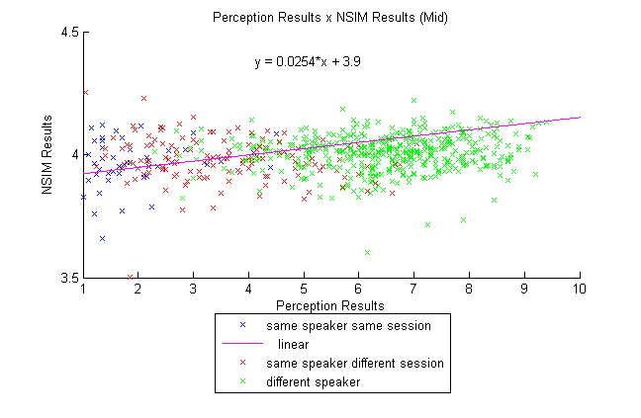
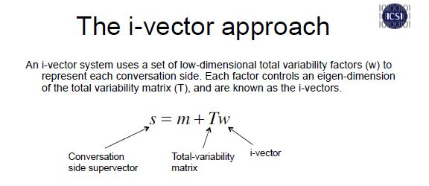



Speaker Recognition
UCLA Summer Undergraduate Scholars Program
Speech Process and Auditory Perception Lab
Rene Plowden, Scott Shi, Soo Jin Park, Abeer Alwan
Introduction: How do you recognize a voice?
Speech Chain
Excitation
Vibration of the vocal folds.
Filter
Resonances are introduced
to the original signal as
sound travels through
the vocal folds.
Features
Source Filter Theory
Describe
What features
are
Problem Description: How do we find a feature that allows machines to recognize voice?
Challenges
Stimuli
Perceptual Results
-Low intersession variability
*extraneous factors
-High interspeaker variability
*non-imitable
Vowel sample (/aa/) from 5 speakers
Each speaker recorded across 3 sessions
3 samples were recorded each session
Total of 45 tokens
60 listeners
Judged if two samples
were from the same speaker or
two different speakers and
provided their confidence
- Aggregated results from
12,600 comparisons
Proposed Solution: Testing if NSIM, PESQ, or iVector can be useful in speaker recognition
PESQ
NSIM
iVector
Wireless Health Research & Education
REU Site funded by NSF award #1263390.
UCLA Henry Samueli School of Engineering and Applied Science

